Slide 1
AIAA@UCSD
American Institute of Aeronautics and Astronautics
1st General Body Meeting
Henry G. Booker Conference Suite
October 9, 2008
AIAA@UCSD

Slide 2
Meeting Agenda
AIAA@UCSD Board
Open Positions: How YOU can be an active AIAA member!
Design Competitions/Research Projects
  Design, Build, Fly
  AUVSI UAV
  Microgravity
AIAA@UCSD Mentors
AIAA National Membership
Upcoming Events
  Edwards AFB Technical Talk
  SDASM Green Skills for Life
  Employer Presentations
Questions/Comments
FOOD! Officer’s Mix&Mingle (in the Booker Den)
AIAA@UCSD

Slide 3
AIAA@UCSD Board
Chair – Brian Preedanon
Vice-Chair, Programming – Jacqueline Yu
Vice-Chair, Fundraising – Andrew Chen
Vice-Chair, Membership – Andrea Wong
Vice-Chair, Publicity – Brandon Maryatt
Treasurer – Gabriel Hribik
Secretary – Liliana Zhou
Webmaster – Derek Peterson
Outreach – Rory Miller
TESC Representatives – Arvin La Rosa
AUVSI Project Manager – Karthik Balakrishnan
Microgravity Project Manager – Timothy Havard
Microgravity Project Manager – Christie Carlile
Board Assistant – Julia Stalder
AIAA@UCSD

Slide 4
Open Positions
TESC Co-Representative
  Participate with TESC events and committees in representation of AIAA@UCSD
Project Managers
  Various design and research/paper projects available
  Start a UCSD tradition! Become a project founder!
Board Assistants
  Actively participate in board meetings, assisting officers
    Programming
    Fundraising
    Publicity
    Outreach
  Gain leadership experience
Interested? Contact Brian! (bpreedan@ucsd.edu)
AIAA@UCSD

Slide 5
Programming
Jaqueline Yu
Vice-Chair, Programming
jay002@ucsd.edu
Responsibilities
  Organize speakers, tours, socials and logistical details of events
  Coordinate with professionals for info sessions and technical talks
Opportunities to influence AIAA events and acquire organizational skills, as well as opportunities to make industry contacts
AIAA@UCSD

Slide 6
Fundraising
Andrew Chen
Vice-Chair, Fundraising
d6chen@ucsd.edu
Responsibilities
  Raise money for AIAA@UCSD and supported projects/events
Opportunities to make industry contacts, develop communication skills, and business management
AIAA@UCSD

Slide 7
Publicity
Brandon Maryatt
Vice-Chair, Publicity
bmaryatt@ucsd.edu
Responsibilities
  Distribution of information
    Flyers/posters
    Newsletters/Listserv
Creative, easy way to get involved in AIAA and spread industry knowledge to the public
AIAA@UCSD

Slide 8
Outreach
Rory Miller
Outreach Chair
r3miller@ucsd.edu
Responsibilities
  Organize volunteering and community service activities/events throughout UCSD and San Diego
  Manage AIAA@UCSD Mentors Program
Contribute to the UCSD and San Diego communities while emphasizing the importance of math, science, and technology
AIAA@UCSD

Slide 9
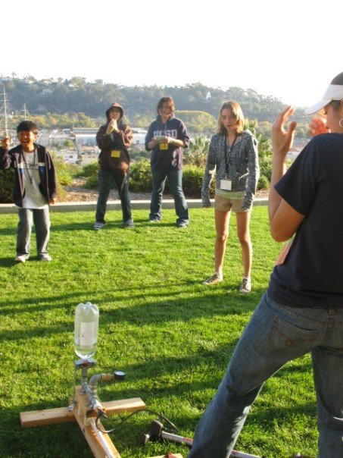
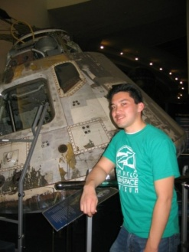
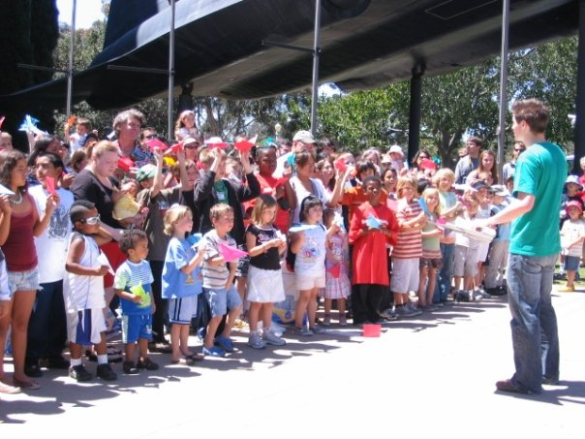
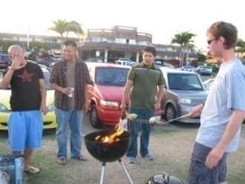
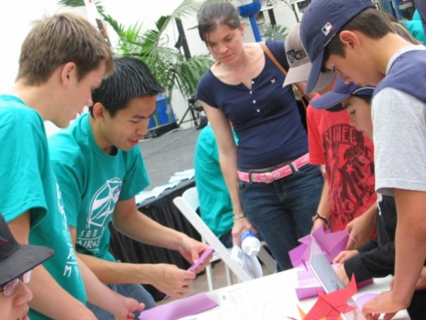
AIAA@UCSD Mentors
Interested in inspiring and motivating a freshman to aviation greatness?
Become a mentor!
Purpose:
To help guide underclassmen through their first years at UCSD by pairing them up with an upperclassmen mentor that shares similar goals for their careers both at UCSD and beyond graduation!
Benefits for Mentees:
Assistance with 4-year plans, resumes, as well as guidance through
internships and co-ops & a chance to share your interests with another person in your field!
If you’re interested, email Rory (r3miller@ucsd.edu), and you will be sent a short questionnaire to fill out so that the best mentor/mentee pairings can be made!!!
Deadline for Mentor/Mentee submittals → THURSDAY, 10/16/08
AIAA@UCSD

Slide 10
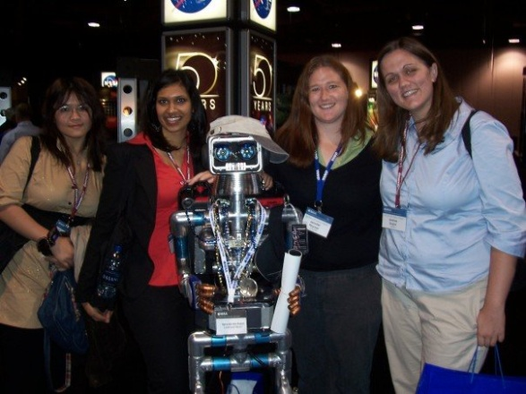
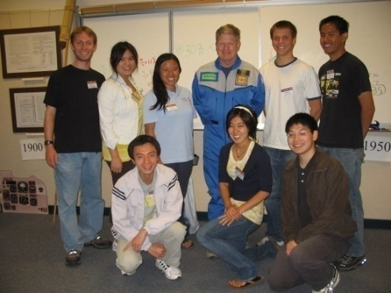

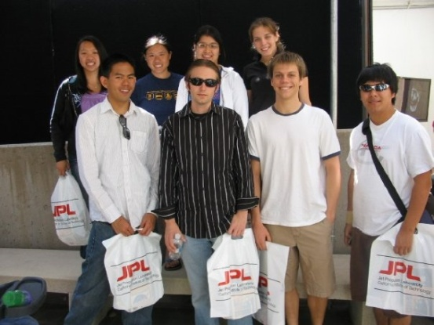
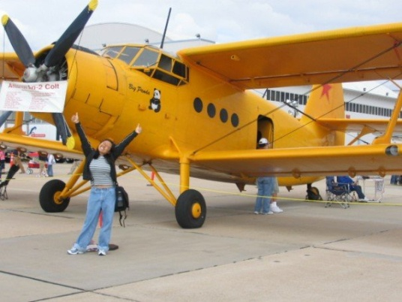
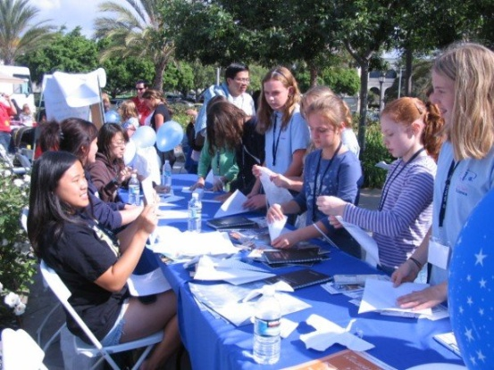
Previous Events
Space 2008 Conference
Miramar Air Show
Education Alley
Graduate Panel
Industry Panel
JPL Open House
Northrop Grumman Job Shadowing
Edwards AFB Technical Talks
(Northrop) Dr. Michael Markow: Secrets of HR
Industry Info Sessions
Technical Seminars (Excel, MATLAB, etc…)
Study Breaks: Game Night, Bonfire
UCSD Engineering Community/TESC
  Triton Junkyard Derby
  E-Week
  Engineering Explorations / Enspire
  DeCAF
AIAA@UCSD

Slide 11
Design Competitions
Design, Build, Fly
  Undergraduate team designing an R/C aircraft under mission requirements
  Project Manager: (TBD)
AUVSI UAV
  Undergraduate team with the goal of designing a completely autonomous UAV
    Autonomous takeoff, waypoint navigation, sensor-based target recognition, and landing; real time imagery
  Looking for students interested in image processing, API development, electric power systems, and R/C aircraft flight
  Project Manager: Karthik Balakrishnan (karthik@ucsd.edu)
AIAA@UCSD

Slide 12
Research Projects
Microgravity
  Undergraduate research team developing an experiment for low-gravity environments
  Flown on the Weightless Wonder (Vomit Comet)
  Competitive program through NASA’s Microgravity University
  This year’s project involves (don’t laugh) free stream breakup
  Limited open positions available for non-senior students
  Project Manager: Timothy Havard (timwillhav@gmail.com)
  Christie Carlile (ccarlile@ucsd.edu)
AIAA@UCSD

Slide 13
Become a Project Manager
Plenty of design competitions, paper competitions, and research opportunities
Benefits of starting a program:
  Full support from AIAA@UCSD, including assistance in getting your program started
  Gain leadership and team management experience
  Exercise knowledge gained from courses and actively apply them to the real world
  Become a founder of a UCSD tradition
  Support the growth of knowledge, information, and technology in our modern world
AIAA@UCSD

Slide 14
AIAA National Membership
Student Membership Benefits ($20/yr)
  Access to the latest technical information and news
  Endless opportunities to network with today's aerospace leaders
  Resources to support your career and professional development
  Student discounts on professional conferences, local section events, and technical meetings
  The ability to participate in design and research competition
  A free magazine subscription to Aerospace America and the AIAA Student Journal
  Scholarship Opportunities!!!
Register online! (www.aiaa.org)
AIAA@UCSD

Slide 15
Communications
National
  Website: http://www.aiaa.org/
San Diego Section
  Website: http://www.aiaa-sd.org/
UCSD Chapter Information
  Website: http://aiaa.ucsd.edu/
Email Listserv
  Newsletters; Contact Andrea! (arwong@ucsd.edu)
Facebook Group
  (UCSD Network - Search: AIAA)
AIAA@UCSD

Slide 16
AIAA@UCSD
UPCOMING EVENTS
AIAA@UCSD

Slide 17
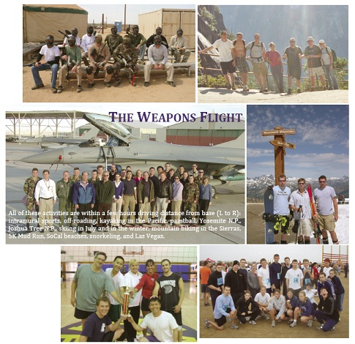
F-35 Joint Strike Fighter Technical Talk
Date:
Wed., October 15, 2008
Time:
4:00pm - 5:30pm
Location:
Booker Conference Suite
EBUI 2512
Presented by Chris Klug, the Lead Armament Engineer on the F-35 Joint Strike Fighter at the Air Force Flight Test Center, Edwards AFB, CA.
AIAA@UCSD

Slide 18
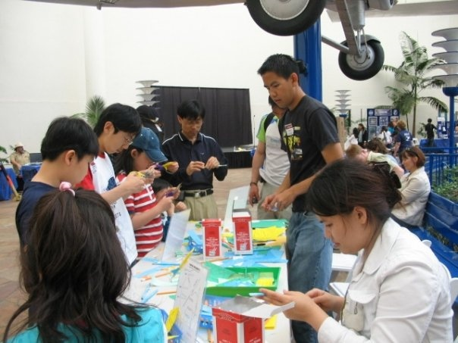
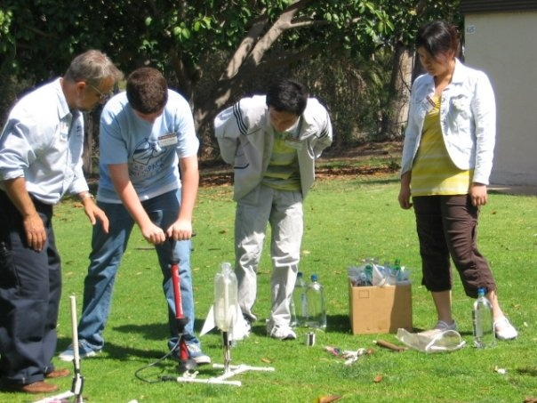
San Diego Air and Space Museum
"Green Skills for Life"
Date:
Saturday, October 18, 2008
Time:
8:00am - 3:00pm
Location:
Gilman Parking Structure
SD Air and Space Museum
Family-oriented, educational event where kids can learn Super Hero skills to save the planet and participate in hands-on activities.
LIMITED SPOTS! Reply to Brian (bpreedan@ucsd.edu) ASAP!
AIAA@UCSD

Slide 19
Other Events @ UCSD
Fall Festival on the Green
  Friday, October 10, 2008; 11:00am – 2:00pm on Library Walk
  Speak with AIAA@UCSD board members!
Boeing Information Session (with Tau Beta Pi)
  Wednesday, October 22, 2008; 5:00pm – 8:00pm at EBUII 584
  Presentation and one-on-one discussions! Bring your resumes!
Triton Job & Internship Fair
  Wednesday, October 22, 2008; 10:30am – 2:30pm on Library Walk
  Employer information tables! Bring your resumes!
Port Triton Employer Presentations
  Oct 14, 2008 5:00 pm McMaster-Carr
  Oct 22, 2008 5:00 pm Northrop Grumman Corporation
  Nov 05, 2008 7:30 pm Lockheed Martin
  Nov 06, 2008 5:00 pm Raytheon
  Nov 17, 2008 5:00 pm Jet Propulsion Laboratory (JPL/NASA)
  RSVP at Port Triton website! (https://ucsd-csm.symplicity.com/students/)
AIAA@UCSD

Slide 20
AIAA@UCSD
American Institute of Aeronautics and Astronautics
AIAA@UCSD

